Slide 1

Hangman inspired game

Slide 2
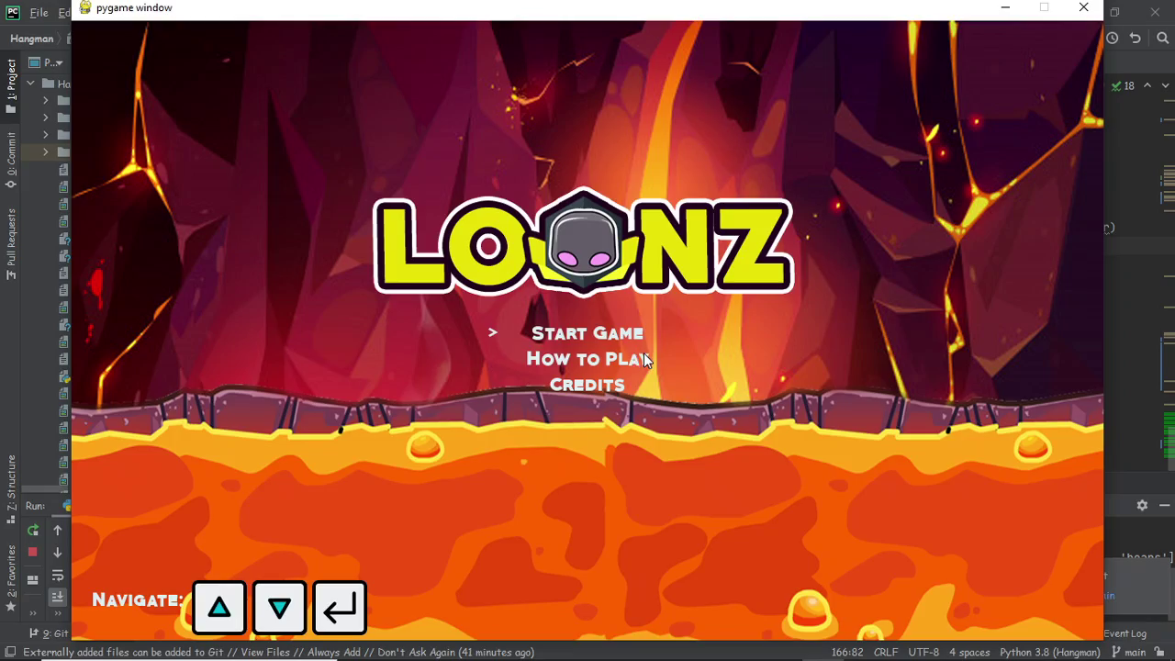
This game is inspired by the classic letter guessing game called Hangman..

Slide 3
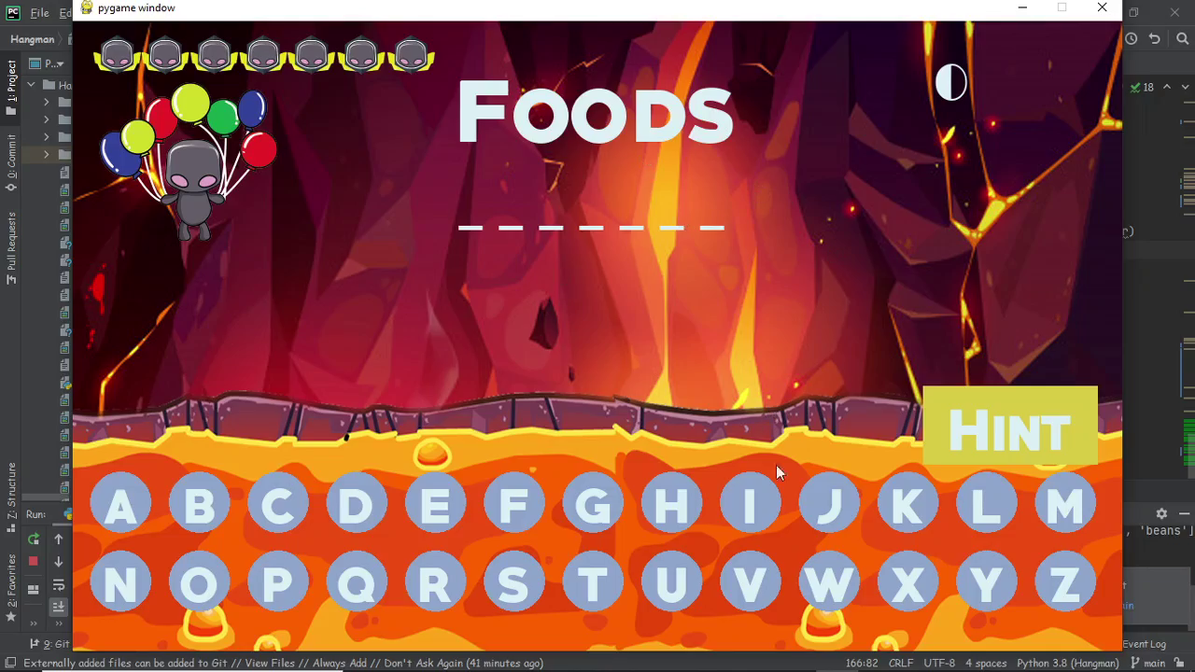
You are shown a set of blank letters that match a word based on a category and you have to guess what these letters are to reveal the hidden word

Slide 4
You guess by picking letters from those displayed at the bottom

Slide 5
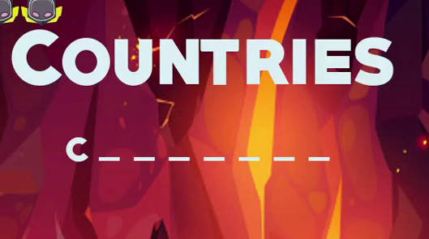

One hint is given for every word.

Slide 6
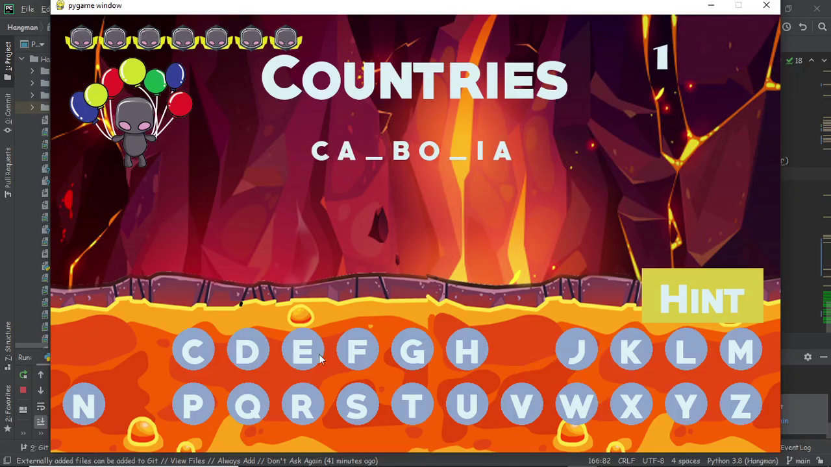
If you pick a letter that is in the word, that letter is revealed from the blank letters

Slide 7
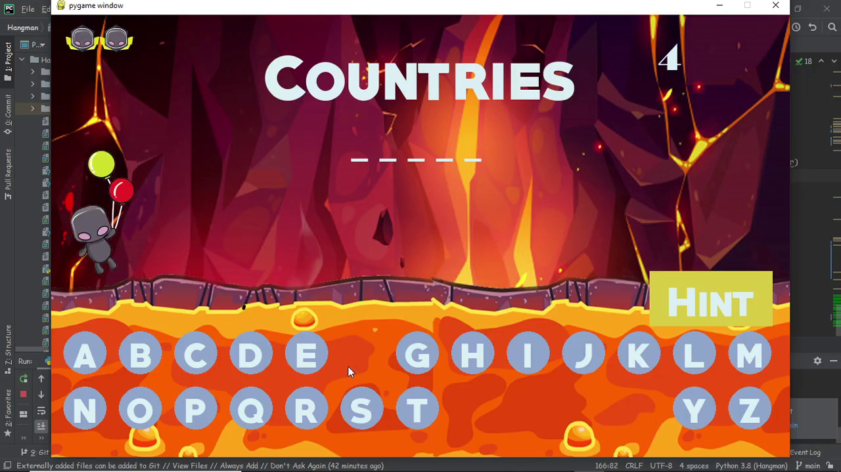
With each wrong letter guess, the balloons pop one by one and player’s life will get deduction for each lost balloon

Slide 8
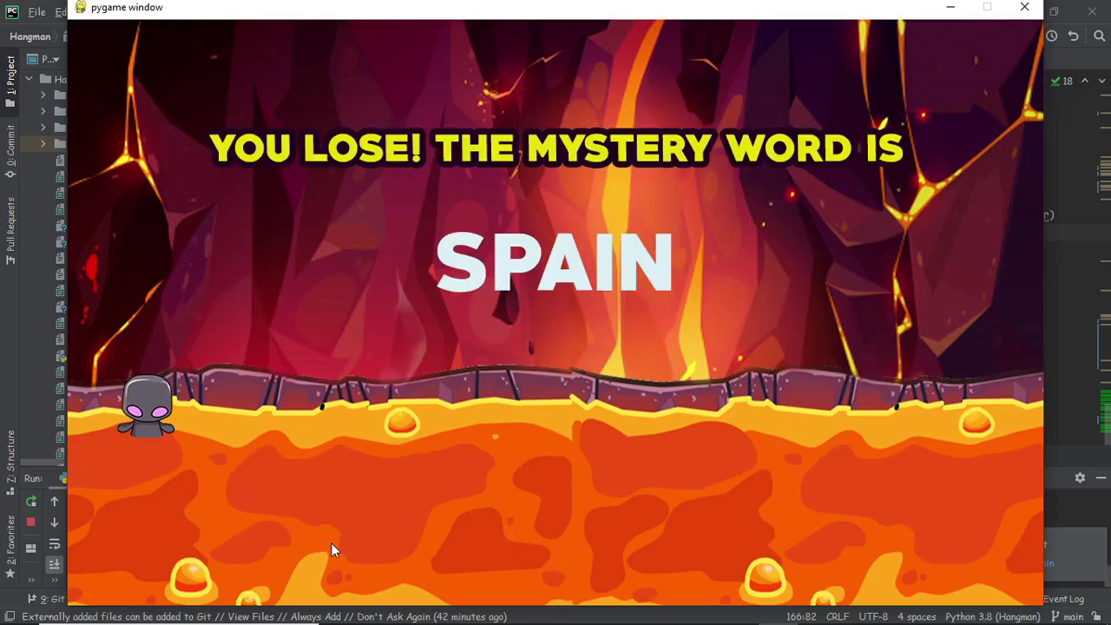
Losing all the balloons makes the player slowly fall into the lava

Slide 9
